Slide 1

Raspberry Pi 4 Navigation System for the Visually Impaired
David Conrad

Slide 2

David Conrad
Transferred to Indiana University Southeast
To complete the process of transferring, I needed to visit several different buildings in IUS Campus
1) Visit admissions
2) Visit the advising office
3) Visit University Professors
3) Find my classes

Slide 3
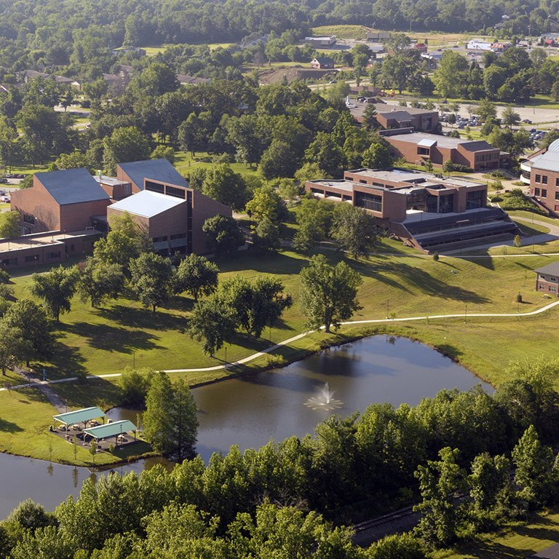
Beautiful Campus
While small, the campus doesn’t feel small to someone brand new.
Several different buildings to visit
Confusing for someone new

Slide 4
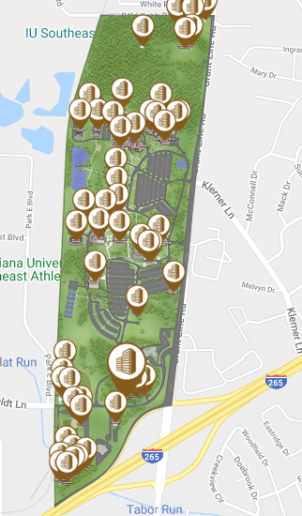
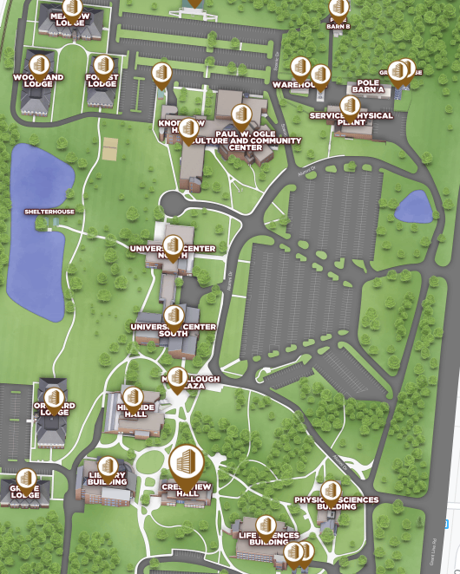
Very well-done map on one IU
I didn’t have access to one IU

Slide 5
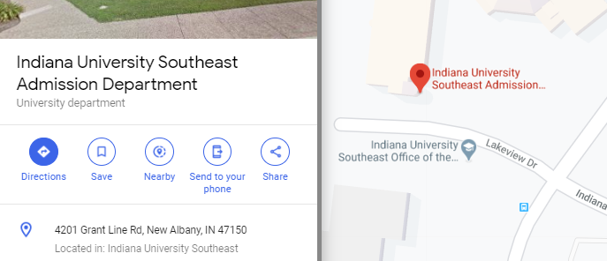
Google Maps
Navigates the user to admissions
Doesn’t get you to individual buildings

Slide 6
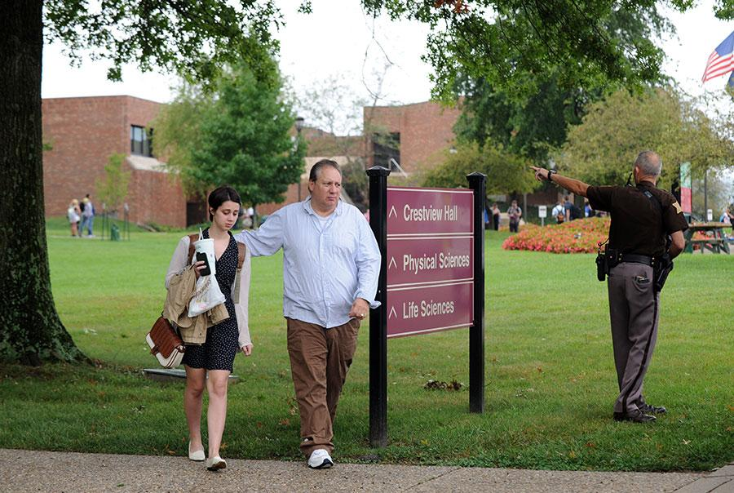
What about signs?
IUS has wonderful signage that guided me.
Not everyone can read signs.
Often, when I have an issue, I think of how it could be worse for someone who wasn’t as blessed as I was.
How would someone who was visually impaired navigate?

Slide 7
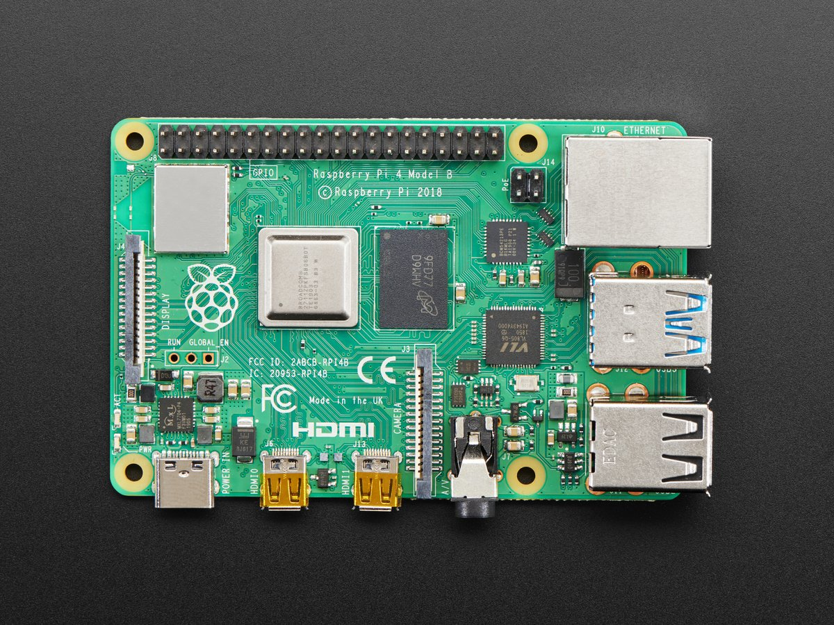
How can I use a Raspberry Pi in a system that allows navigation for the blind?

Slide 8
Initial Research
Form the problem and question
Research
Build
Identify New Problems
Test
Record Observations
Summarize and Conclude

Slide 9
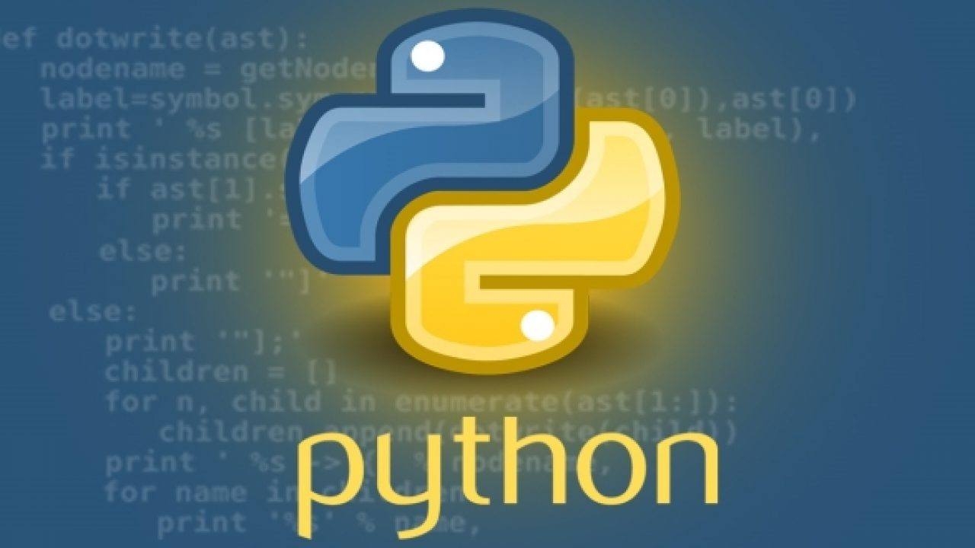

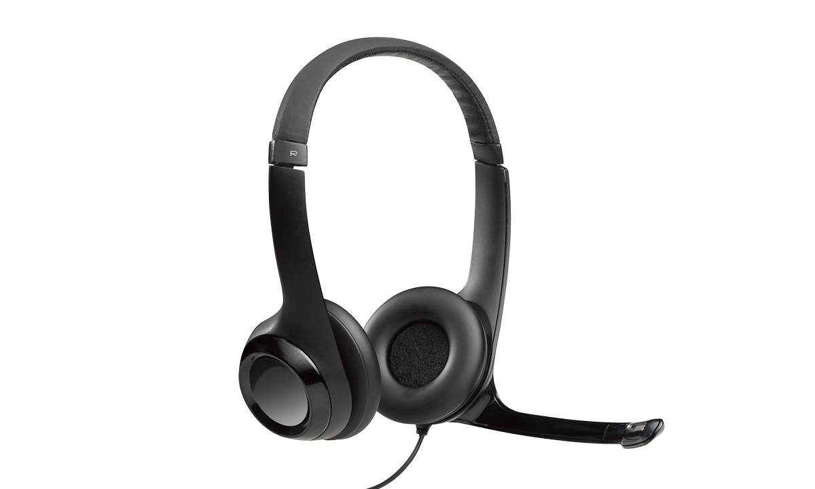
Initial Ideas and Research
Python
Google speech to text
Google Geolocation
Google text to speech API
Microphone/Headphones
Raspberry Pi

Slide 10
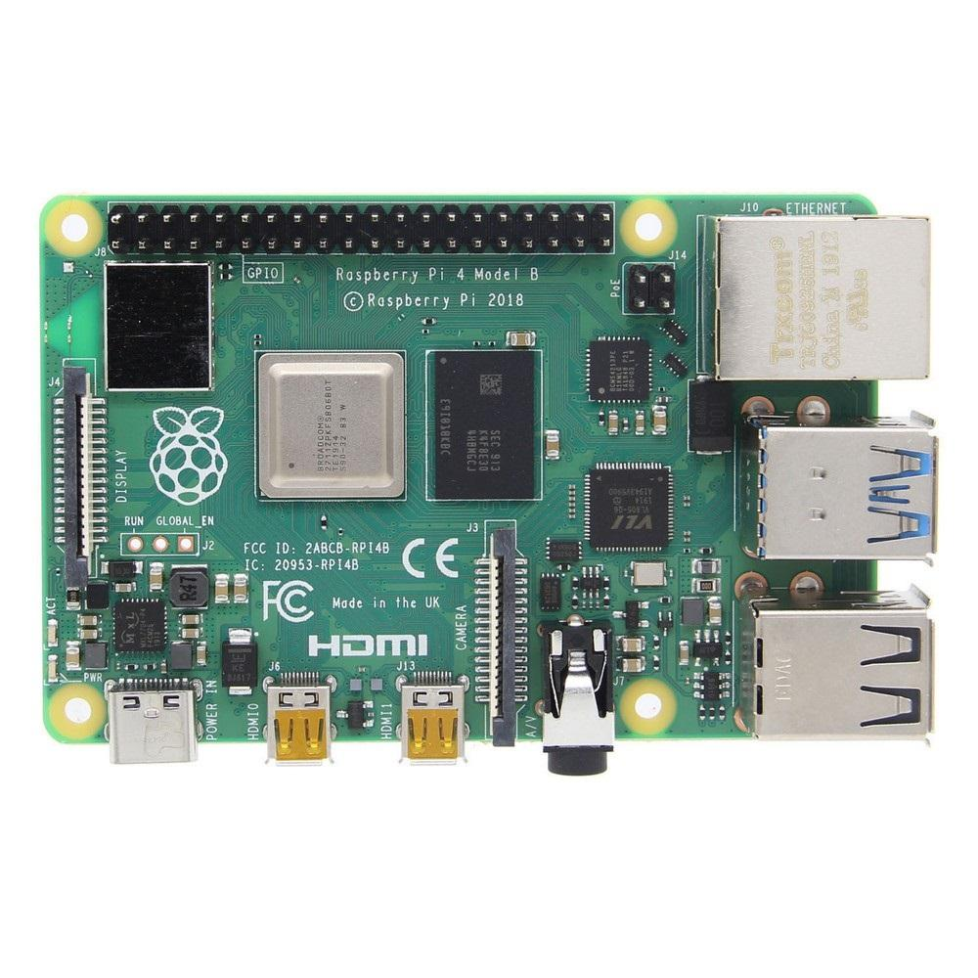
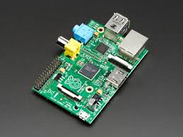
More Research and Starting to Build
Raspberry Pi 1 vs 4
Micro USB vs USB C Power
Micro HDMI vs Component
Keyboard and Mouse
3.0 Volt power
Monitor

Slide 11
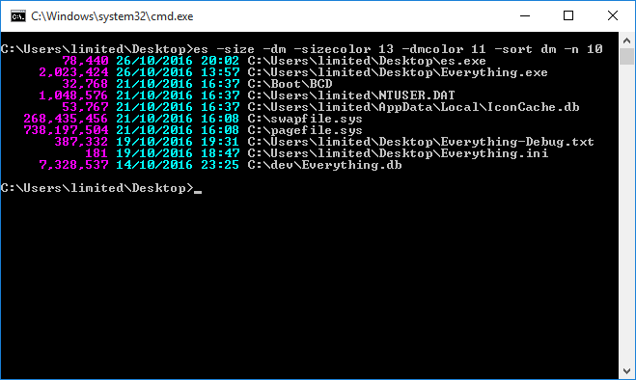

Building and Research
Raspbian
Linux Debian
Command Line
Ease of Building, Windows Remote Desktop vs SSH

Slide 12

Research and Building
Pycharm IDE and Thonny
Began experimenting with Python on the Pi

Slide 13
First Building Problems
Python
Google speech to text
Required Voice Recording File Creation
Required Wifi
Google Geolocation
Required Wifi
Google text to speech API
Required Wifi
Headphones
Microphone

Slide 14

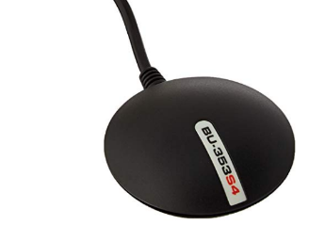
Research, Building, and Lessons Learned
USB GPS Puck
NMEA Data, GPSD
Calculate Distance, Geopy

Slide 15

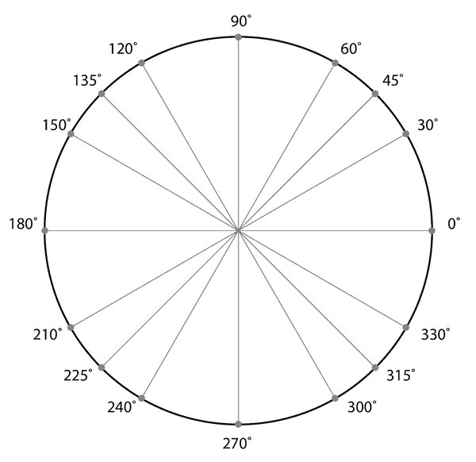
Determine Direction
Calculate the difference between the destination heading and the user’s current heading
Lay a Unit circle flat on your hand
Imagine the destination is at 0 degrees
Imagine the difference in the two headings is where you are facing
Then, we know where we are facing: The difference
And we know where we want to be: Zero Degrees
Determine the Turn
Set up Cases for each turn in 30-degree increments

Slide 16
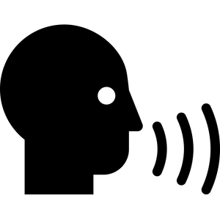
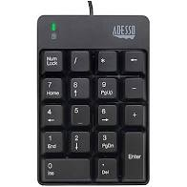

New Problems, Research, and Solutions
Jasper
Speech to Text Class Developed in 2015
Outdated
Tactile Numpad
Festival Lite Text to Speech from Carnegie Melon

Slide 17
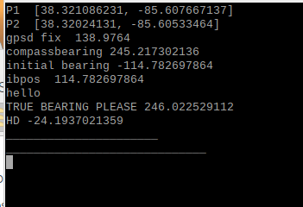

Slide 18
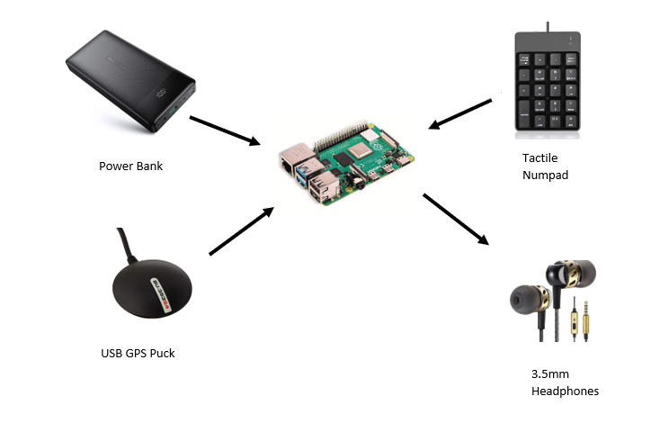

Slide 19
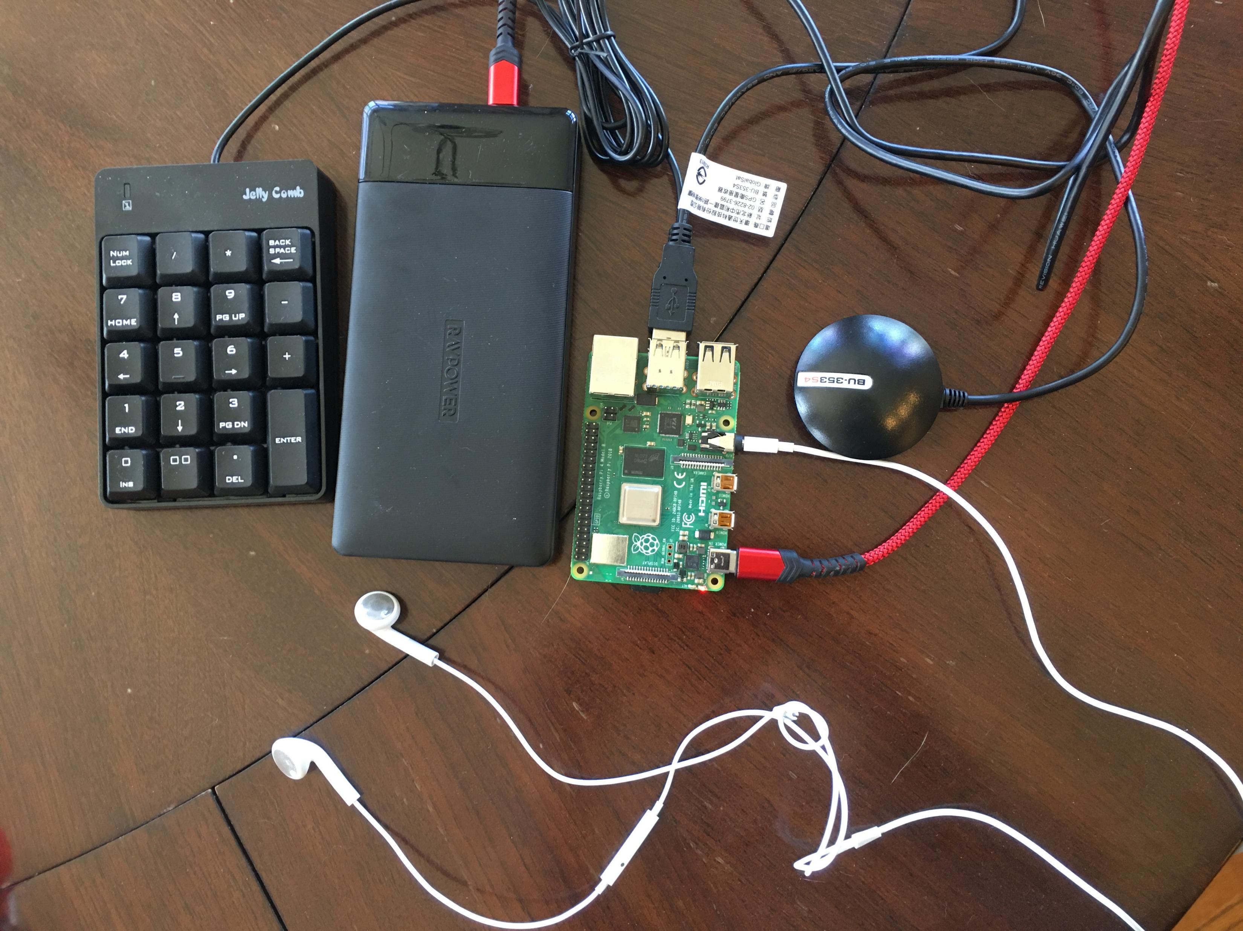
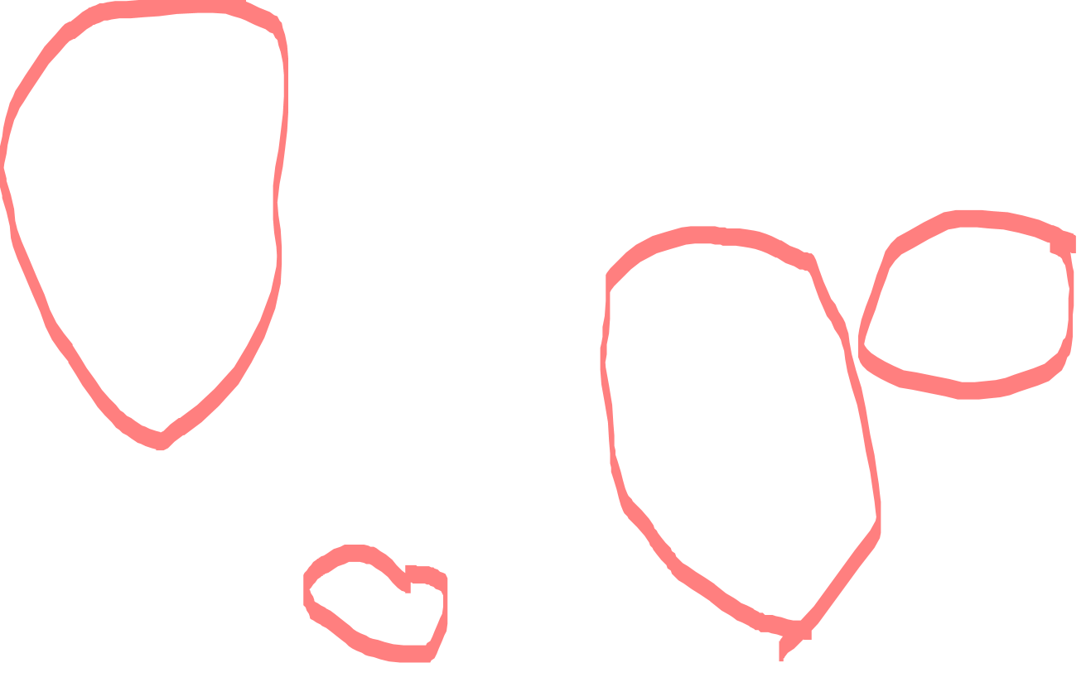

Slide 20

Disabilities Resources Center Office of Admissions

Slide 21
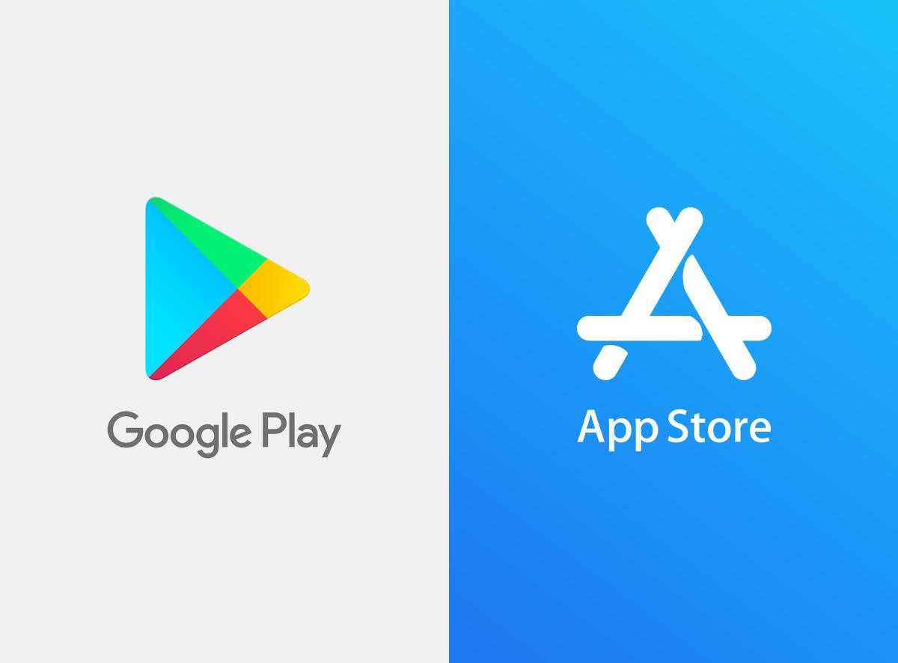

Slide 22

Why stop with IUS

Slide 23
David Conrad
Conradd@IU.edu
502-381-3806

